Slide 1
Job Posting Analysis and Data Cleaning using Python

Slide 2
Table of Content
Introduction
Background
Data Collection & Processing
Exploratory Data Analysis
Results
Recommendations
Future Work
Conclusion

Slide 3
Introduction
In today's job market, data plays a crucial role in making informed decisions for both job seekers and employers. In this project, we used Python to analyze job postings with the goal of finding meaningful information that will be useful to recruiters, employers, and job seekers alike.

Slide 4
Background
Job posting analysis involves examining datasets scraped by Data Engineering Interns to uncover valuable insights and trends in the job market.
Project Objectives
❑ Utilize Python libraries and tools to perform EDA on the collected job data.
❑ Identify trends, patterns, and insights related to the different technology jobs.
❑ Visualize the analysis results using appropriate charts, graphs, and visual representations.

Slide 5
Data Collection & Processing
Data engineering interns gathered the datasets from different sources while we conducted data cleaning for analysis.
Removing duplicates
Handling missing values
Standardizing formats
Correcting errors

Slide 6
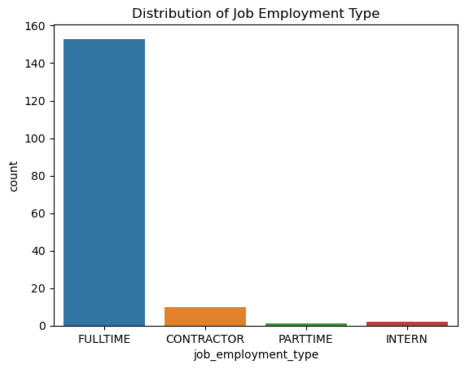
Exploratory Data Analysis
From this chart, it's evident that most job postings are for full-time positions, comprising approximately 90% of the dataset.

Slide 7
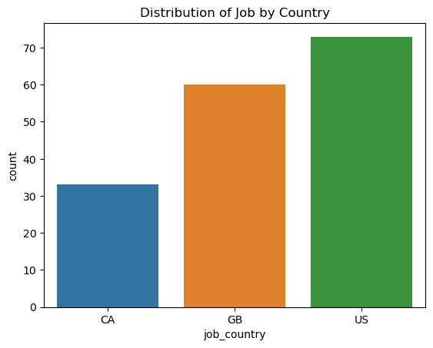
Distribution of job by Country
The United States (US) leads with the highest number of job postings, followed by Great Britain (GB) and Canada (CA).

Slide 8
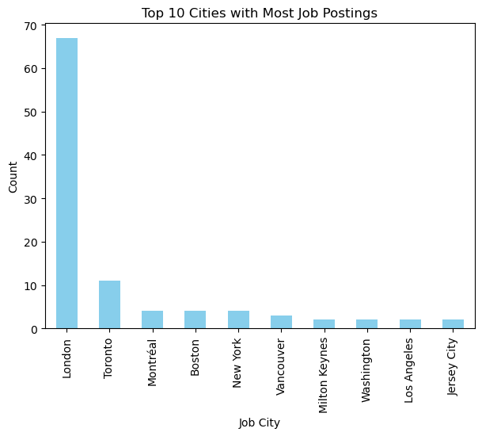
Top 10 Cities with Most Job Postings
London emerges as the top city for job postings, indicating a robust job market in the UK capital. Toronto follows with a significant number of job opportunities, while Jersey City has the least.

Slide 9
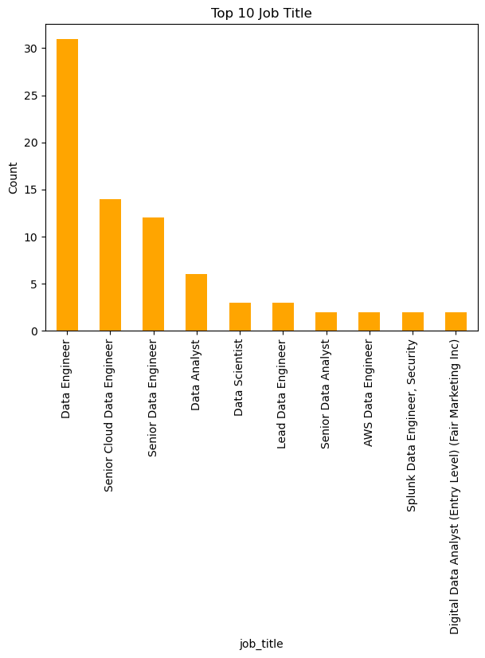
Top 10 Most Job Title Postings
Data Engineer is the most common job title among the postings, with 31 occurrences. This indicates a high demand for professionals skilled in designing, building, and managing data pipelines.

Slide 10
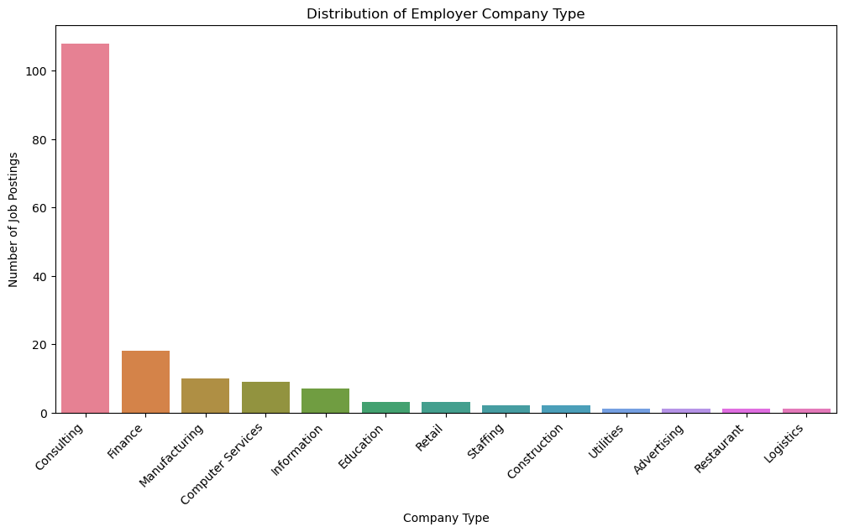
Distribution of Employer Company Type
The consulting industry dominates the job market represented in the dataset, with a significant number of job postings.

Slide 11
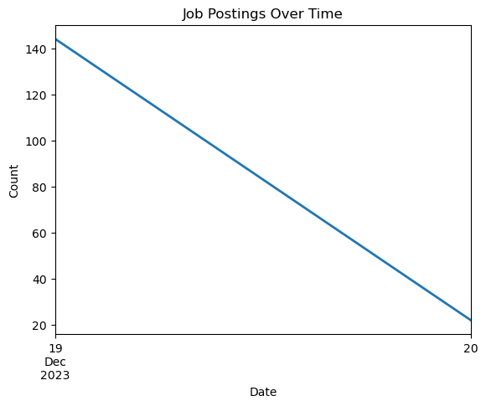
Job Postings over Time
To observe any trends or patterns in job postings over the analyzed time period, after 19th December to 20th December was on decline

Slide 12
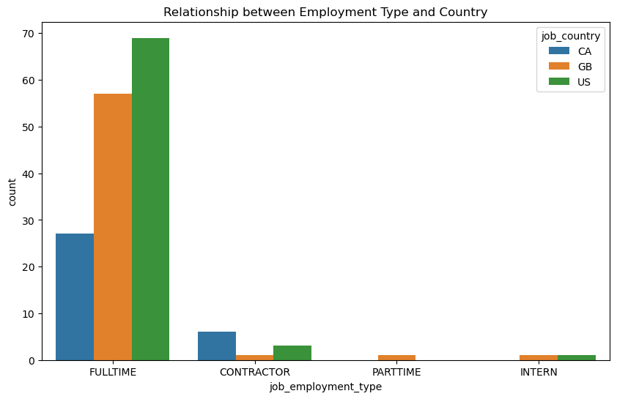
Relationship between Employment Type and Country
The country with the most full-time job posting is US follow by GB and Canada

Slide 13
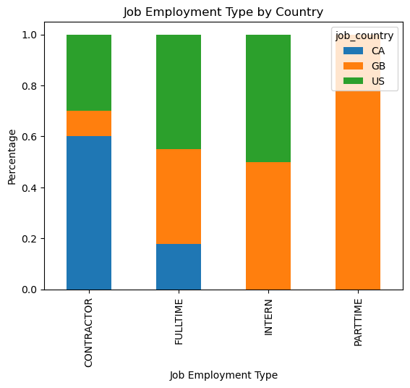
Job Employment Type by Country
In contractor job employment type, Canada has the most job posting amounted to 60% followed US and GB

Slide 14
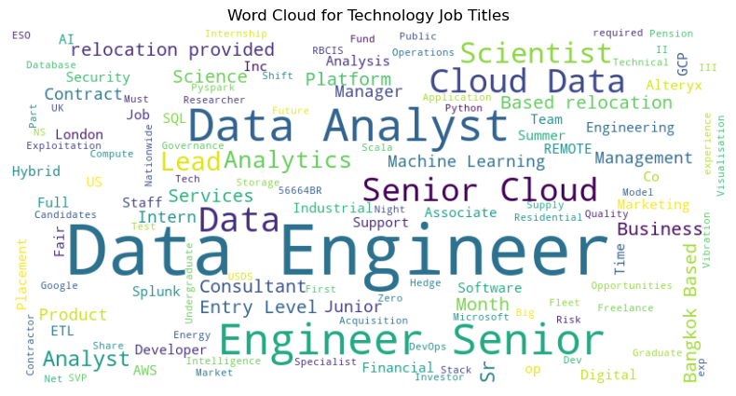
Word Cloud for Technology Job Titles
Data Engineer role is more prominent in the visualization, which means it is the role that is most sort after or posted the most.

Slide 15
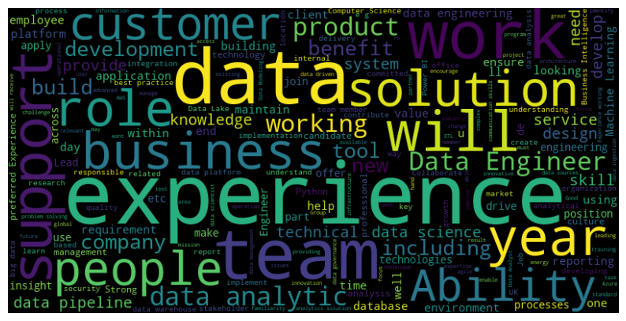
Word Cloud for Job Descriptions

Slide 16
Results
Job Type Distribution:
The majority of job postings are for full-time positions (153), followed by contractor positions (10), internships (2), and part-time roles (1).
Distribution by Country:
The US has the highest number of job postings with 73, followed by Gtain (GB) with 60 postings and Canada (CA) with 33 postings.
Top Cities for Job Postings:
London has the highest number of job postings with 67, indicating a significant concentration of job opportunities in the city while some cities has one posting each, indicating a diverse geographical distribution of job opportunities.

Slide 17
Results (Cont’d)
Industry Insights:
The consulting industry has the highest number of job postings with 108, suggesting a strong demand for professionals in this sector. Finance and manufacturing follow with 18 and 10 job postings, respectively.

Slide 18
Results (Cont’d)
Job Seekers:
Job seekers can use the insights from this project to identify trends in the job market, such as the most in-demand job types, popular industries, and preferred locations for job opportunities.
By understanding the distribution of job types and industries, job seekers can tailor their job search strategies to focus on sectors with higher demand or locations with more opportunities.
Additionally, job seekers can gain insights into salary expectations and industry preferences, helping them make informed decisions about their career paths.

Slide 19
Results (Cont’d)
Recruiters and Employers:
Recruiters and employers can leverage the analysis to understand the competitive landscape of the job market and tailor their recruitment strategies accordingly.
Insights into job type distribution, preferred locations, and industry trends can help recruiters target their recruitment efforts more effectively, ensuring they attract qualified candidates.
Understanding the prevailing salary expectations and industry preferences can also assist employers in designing competitive compensation packages and offering attractive benefits to attract top talent.

Slide 20
Results (Cont’d)
Policy Makers:
Policy makers can use the insights from this project to inform workforce development initiatives and education programs.
By understanding the demand for different job types and skills in specific industries and locations, policy makers can design training programs to address skill gaps and promote employment in high-demand sectors.
Additionally, insights into industry trends and geographical distribution of job opportunities can inform economic development policies aimed at fostering growth in certain sectors or regions.

Slide 21
Results (Cont’d)
These insights provide valuable information about the job market, including the distribution of job types, geographical locations of job opportunities, and dominant industries. This information can be used by job seekers, employers, and recruiters to make informed decisions regarding job searches, hiring strategies, and market trends.
Overall, this project provides valuable insights into the job market, which can help stakeholders make data-driven decisions regarding job searches, recruitment strategies, talent acquisition, and workforce development initiatives.

Slide 22
Recommendations
Employers and recruiters should focus their hiring efforts on regions with high number of job postings, such as London, Toronto, and New York.
Job seekers should consider industries with a high number of job postings, such as consulting and finance to explore potential career opportunities.

Slide 23
Future Work
Continued monitoring and analysis of job posting data can help stakeholders stay abreast of evolving trends and make proactive decisions in the dynamic job market landscape.

Slide 24
Conclusion
The comprehensive analysis of job postings and industry insights provides valuable information about the job market in the dataset. These insights can inform strategic decisions for stakeholders, enabling them to effectively navigate the job market landscape and capitalize on emerging opportunities

Slide 25

Thank you

